Slide 1



Keylogger Project
Name : Korukonda Daniel Blesson
GitHub Link: https://github.com/DanielBlesson/APSSDC_Intership_Final_Project​

Slide 2








Agenda
Introduction
Problem Statement
Project Overview
End Users
Solution and Value Proposition
The "Wow" Factor in Our Solution
Modelling
Results

Slide 3

Introduction
Keyloggers are software tools that record a user's keyboard input including passwords, credit card numbers, and other sensitive information.
They can be used for both legitimate and malicious purposes, making them a powerful but controversial technology.

Slide 4

Problem Statement
The objective of this project is to develop a software keylogger to record keystrokes from a keyboard. The implementation will utilize Python with the PYNUT library for capturing and logging keystrokes. The keylogger will capture keystrokes in plain text and JSON formats, with a Tkinter GUI for control. The purpose of this project is for educational and personal productivity tracking, ensuring legal and ethical use. The keylogger will operate transparently and respect user privacy on personal devices.

Slide 5
Project Overview
Objective
Implementation
Features
Develop a software keylogger to record keystrokes from a keyboard.
Use Python with the PYNPUT library for capturing and logging keystrokes.
Capture keystrokes in plain text and JSON formats with a Tkinter GUI for control.
Purpose
Constraints
Educational and personal productivity tracking ensuring legal and ethical use.
Operate transparently and respect user privacy on personal devices.

Slide 6
End Users
Primary End User
Usage
The person who runs the keylogger on their own computer to monitor their own activities or for educational purposes.
End users interact with the simple graphical interface to start and stop the keylogger and may review the logged keystrokes in the text and JSON files.

Slide 7

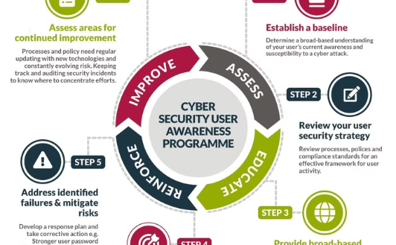

Solution and Value Proposition
Enhanced Security
User Awareness
Compliance
Reduces the risk of data breaches and identity theft.
Educates users about keylogging threats and protection methods.
Helps businesses and organizations comply with data protection regulations.

Slide 8

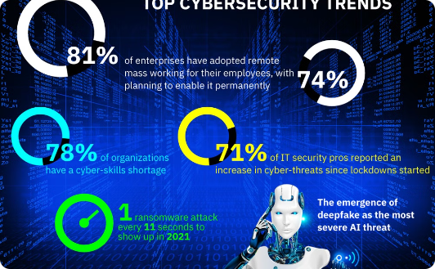

The "Wow" Factor in Our Solution
Advanced Threat Detection
Seamless User Experience
Comprehensive Protection
Our cutting-edge technology delivers a seamless user experience without compromising security, ensuring your peace of mind.
Our solution leverages machine learning to proactively identify and neutralize evolving security threats, providing unparalleled protection.
By going beyond traditional keylogger detection, our solution offers a robust and reliable safeguard for your sensitive information.

Slide 9
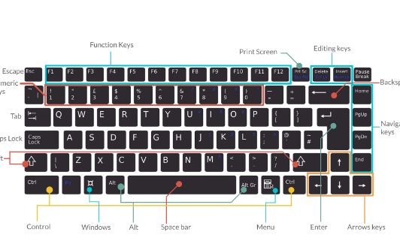
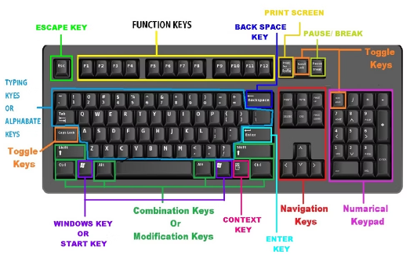
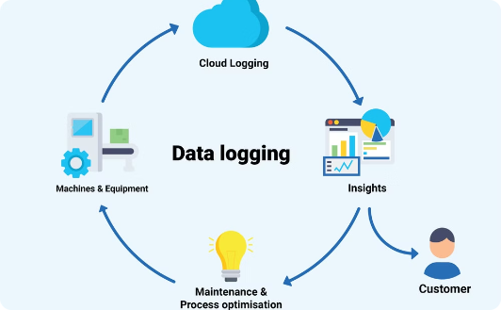
Modelling
Key Press Handling
Key Release Handling
Logging Functions
Captures and logs the pressed keys.
Captures and logs the released keys.
Logs captured data into text and JSON files.

Slide 10
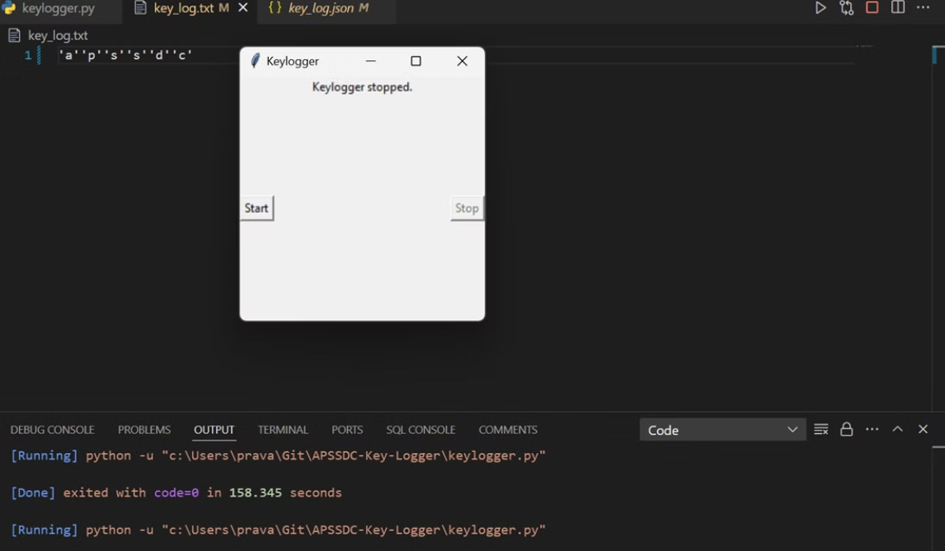
Working

Slide 11
Results
Successfully implemented a keylogger that captures keystrokes and records them into both text and JSON files.
Real-time keylogging with start and stop functionality controlled via a simple GUI.
Emphasized the ethical use of keyloggers and the importance of implementing security measures to protect against malicious use.

